Slide 1
Fast Shutter Speed Assignment
Students will capture motion through the use of a fast shutter speed in order to use manual exposure successfully
You will set your shutter speed to 1/500 or more depending on your subject. Make adjustments accordingly
Since your shutter speed is fast, you will need a wide aperture (F1.4) and an ISO of 100 or 200.

Slide 2
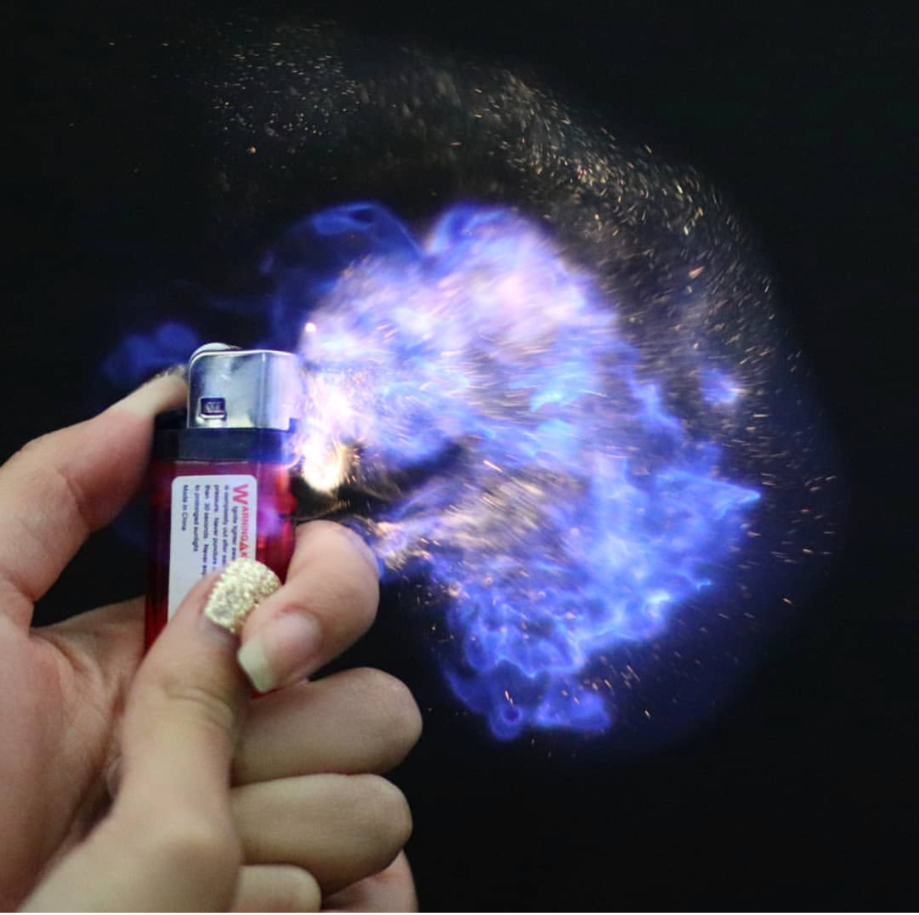

Slide 3
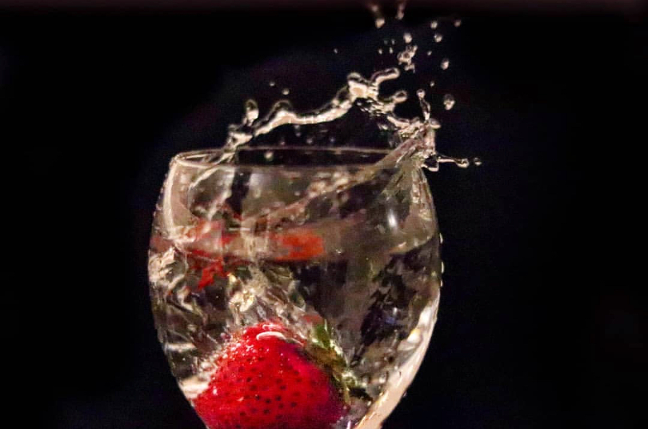

Slide 4
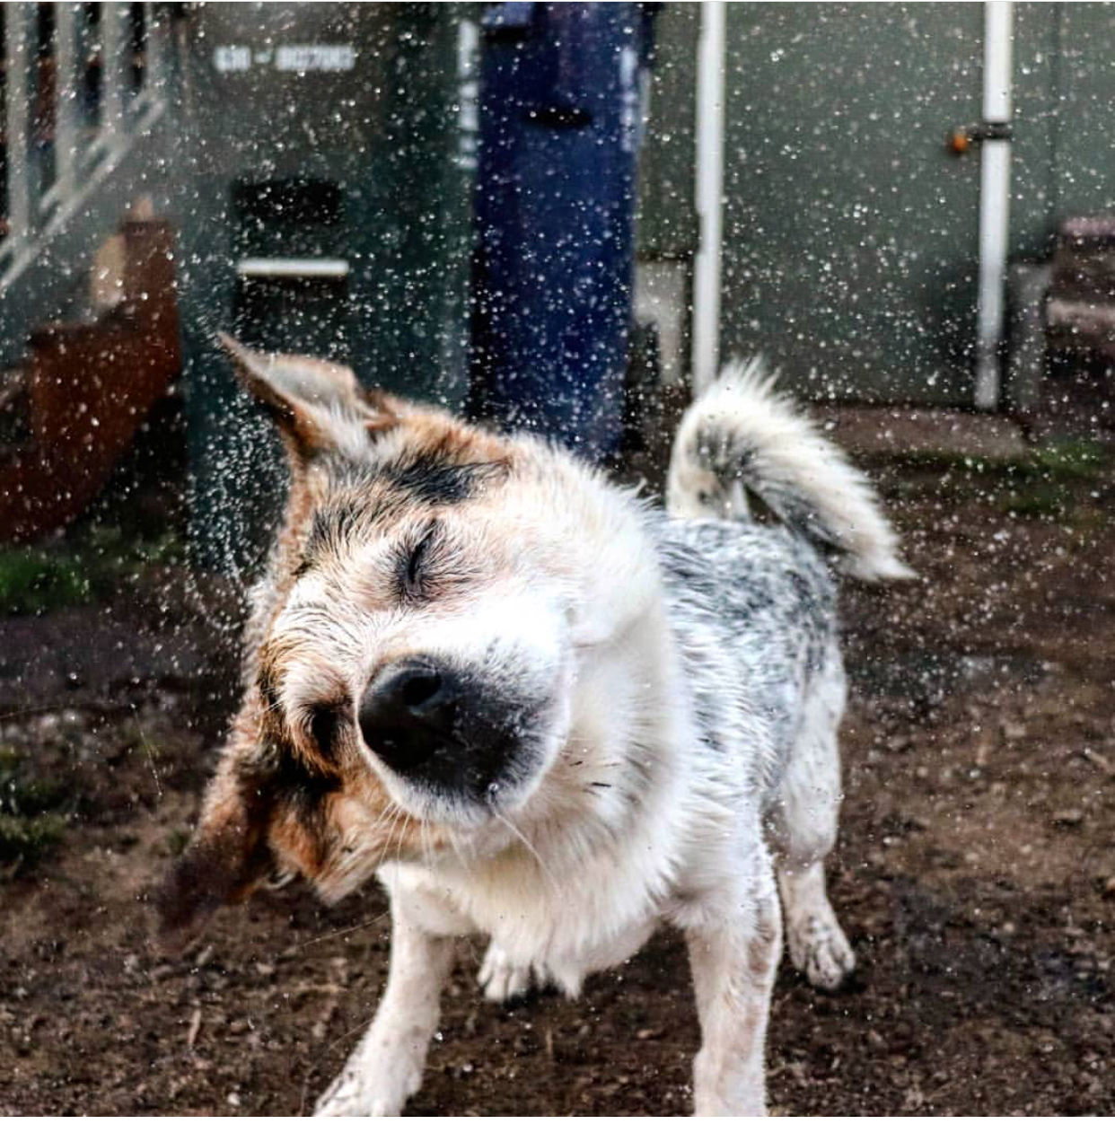

Slide 5
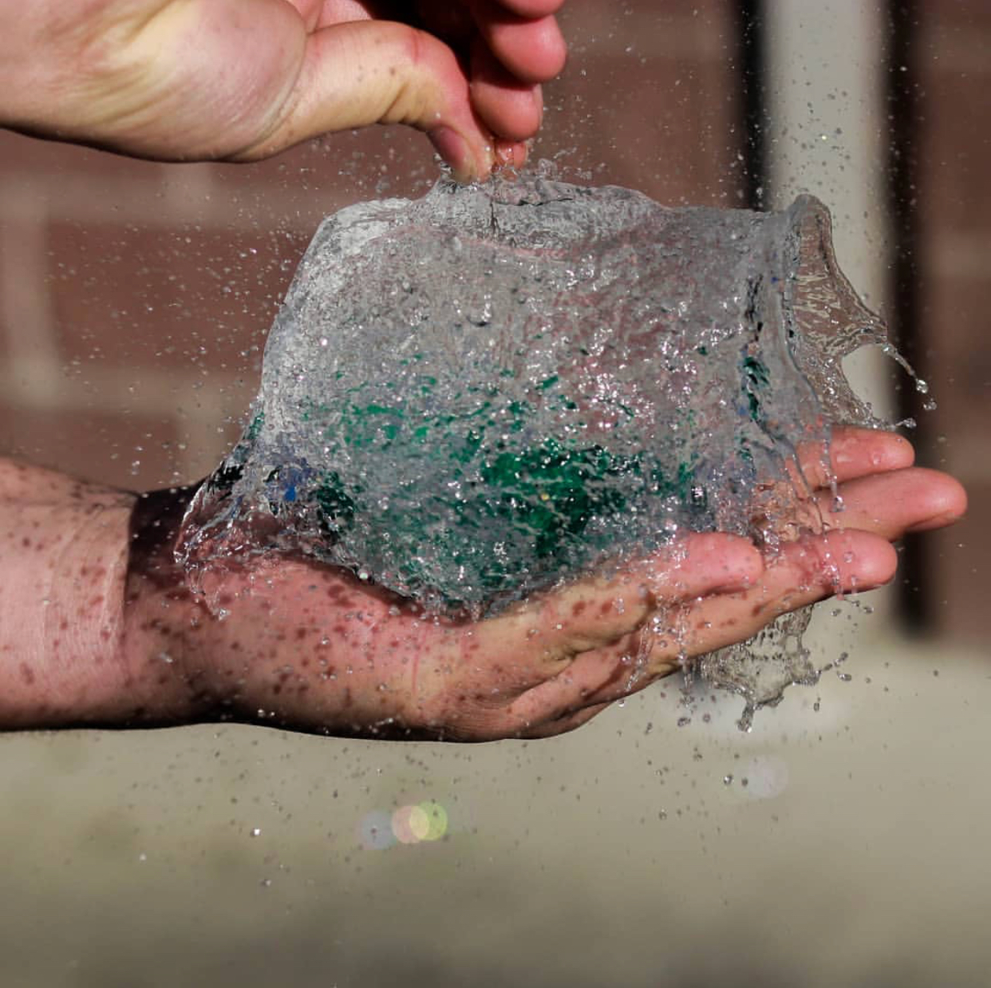

Slide 6
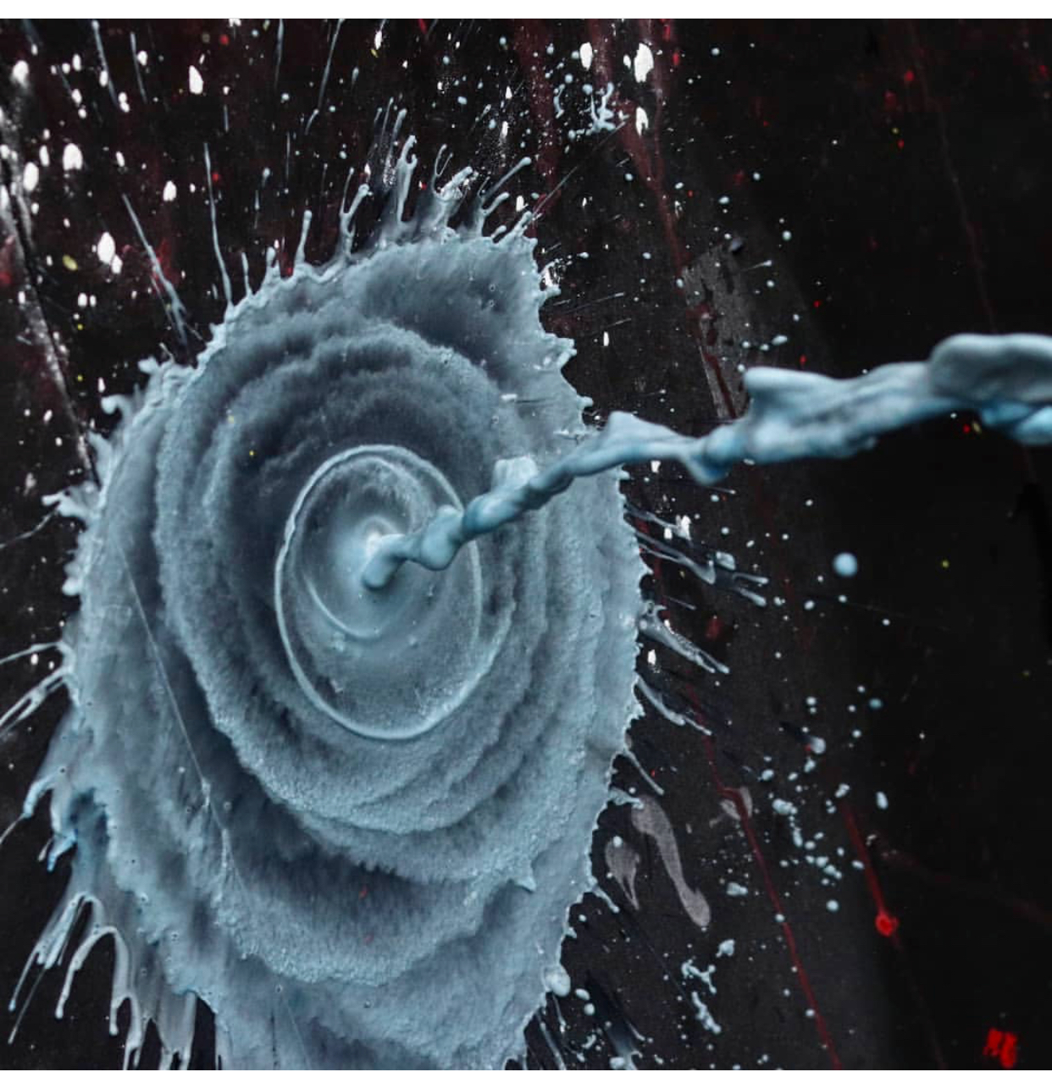

Slide 7
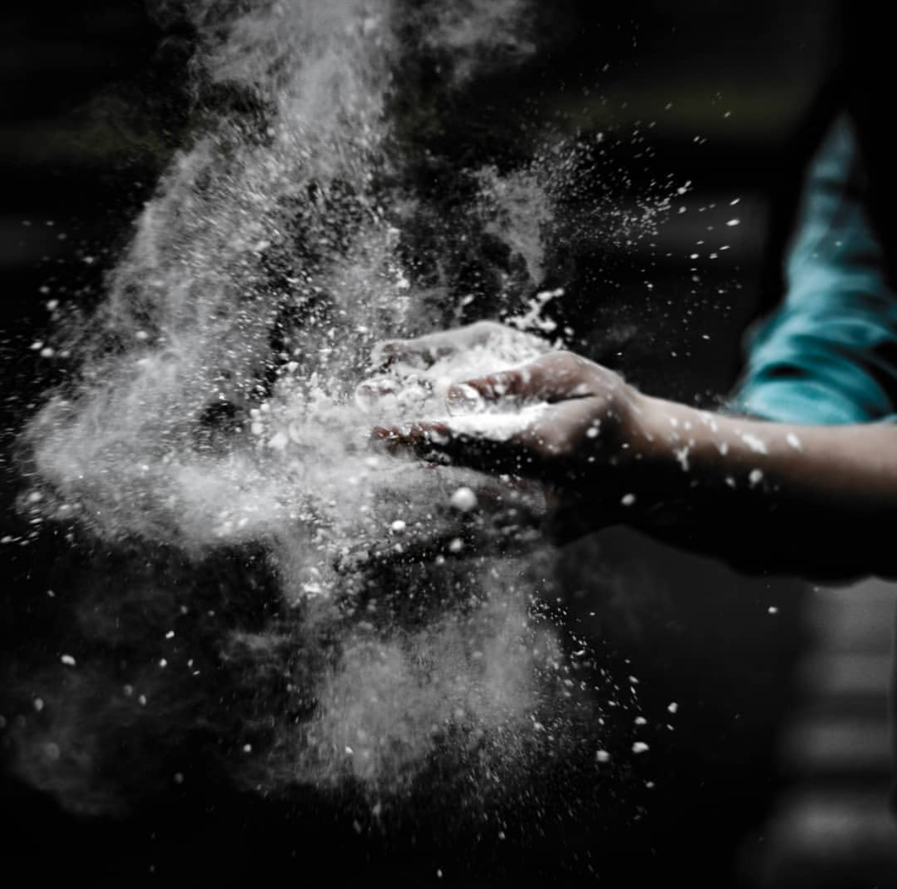

Slide 8
